Slide 1

Analyzing the Coronavirus Curve with SAS
Ching-Ching Wang 40038448
Alexander Guenov 40028815
Chavind Mungun 40062544
Yue Peng 40053397
Prof:
Dr. KRZYSZTOF DZIECIOLOWSKI

Slide 2
CONTENTS
Introduction
Raw Dataset Inspection
Normalyzing Data
Analytics
Summary
Disclaimer
Bibliography

Slide 3
Introduction
MERS-Cov SARS-CoV nCov
Discovery: Dec 19
Statistics Death:121955 Infected:1948874 (Apr 14)
Corona Virus
Origin: Wuhan
China First Pandemic
Symptoms Same as flu
Notes:
“Coronaviruses (CoV) are a large family of viruses that cause illness ranging from the common cold to more severe diseases such as Middle East Respiratory Syndrome (MERS-CoV) and Severe Acute Respiratory Syndrome (SARS-CoV). A novel coronavirus (nCoV) is a new strain that has not been previously identified in humans. ("Coronavirus", 2020)
As of April 14, 2020, 1,948,874 cases are active and 121,955 deaths were due the COVID-19. The epidemic is believed to have its roots in Wuhan, Hubei in mainland China. In mid-March, the United States surpassed China for the highest number of cases[1], but is that due to better access to testing? With the data/information/big data overload we have access to today, it requires analytical skills and computing power to make sense of everything.

Slide 4

Project Goals and Contents
Statistical analysis of the effects of the COVID-19
Present the data in such a way where countries' effective implementation of preventatives measures (such as social distancing, emergency health services, and so) on can be assessed.
Compare the data of these countries
Normalize the data with basic SAS inputs and use PROC FREQ to compare countries.
We will attempt to use PROC GMAP, sgplot and proc means and use a SAS-supplied map data set of the world to make a world map of the key countries ranked by color for their response rating with an Http get request.

Slide 5
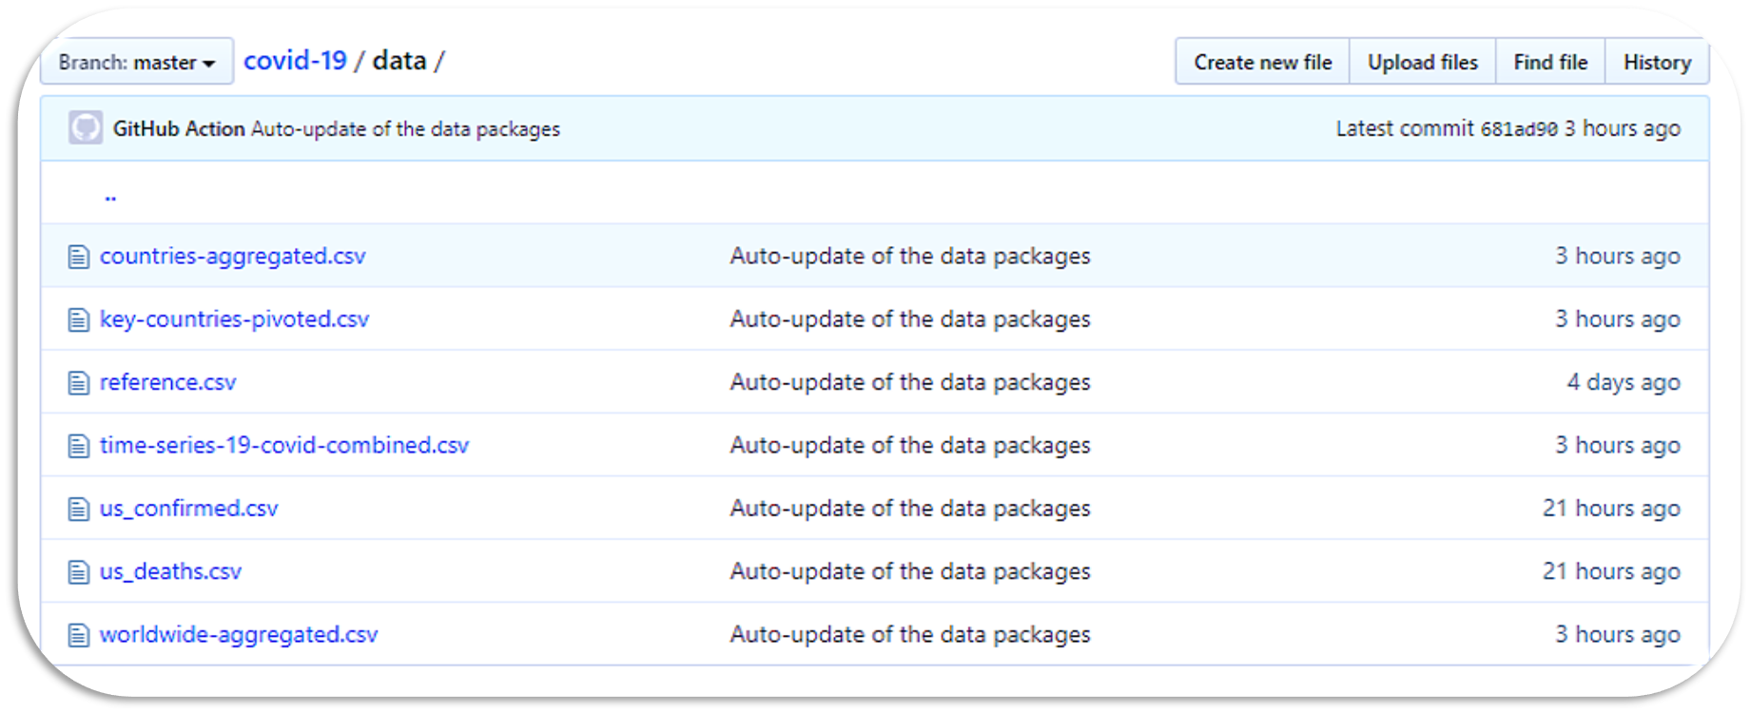
The Dataset
Up to date
22 jan- bcurrentDate
Notes:
We might be using one or more datasets from gitHub. They contains multiple datasets including the key countries cases, deaths and recoveries from January 22nd, 2020 to current day April 14th, 2020. For the purpose of analyzing the key countries, we will use the dataset “countries-aggregated.csv” filtering out a certain number of countries, namely China, USA, UK, Italy, France, Germany, th 83 data points (dates) for each country for about three months of data.We might also briefly cover cases in province in Quebec and some other provinces in Canada.

Slide 6
Global Statements Used
Libname to specifystorage of permanent dataset;
dataset temp where data is temporarily stored
Tell SAS to allow "nonstandard" names
Graphics specifications
libname libraryy "F:\school\BSTA445"; filename probly temp; options validvarname=any; ods graphics on / width=30 in height=30 in outputfmt=gif imagemap=on imagename="Corona" border=off;

Slide 7
Loading the Dataset Into SAS
proc http makes a get request to get an uptodate version of the corona virus Dataset.
It afterwards stores in a temp file called probly.
/*Actual corona dataset*/ proc http url="https://raw.githubusercontent.com/datasets/covid-19/master/data/time-series-19-covid-combined.csv" method="GET" out=probly; run; /*Population */ proc import datafile="F:\school\BSTA445\population\data\population.csv" out=mydata dbms=csv replace; run;

Slide 8
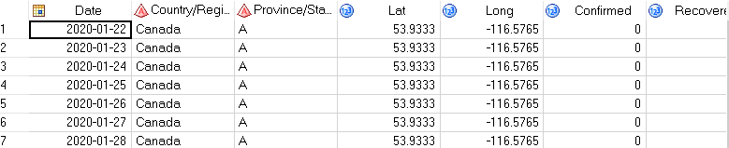
Cleaning & Normalizing the Data
proc import file=probly out=probly replace dbms=csv; run;
Based on the above statement, we are using proc import to get the data and we are normalizing it into table-like structure.

Slide 9
Focusing on Areas
We will be focusing primarily on a specific country, and province and its confirmed cases.
Hence we create a permanent dataset, and let’s filter cases in canada Quebec for now. So we will be using the Data statement with some conditions.
Data libraryy.dataset; Set probly (where= ( 'Country/Region'n = 'Canada' and ('Province/State'n ='Q' ) ) ); Run;

Slide 10
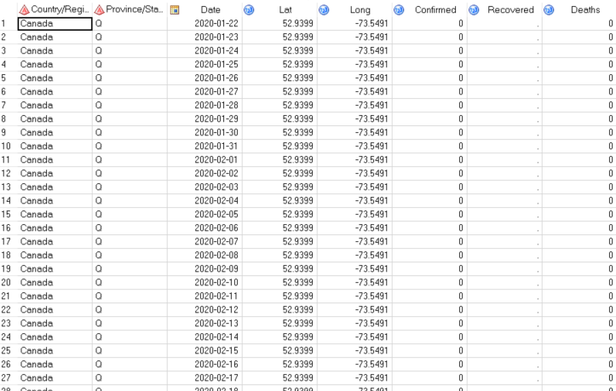

Slide 11
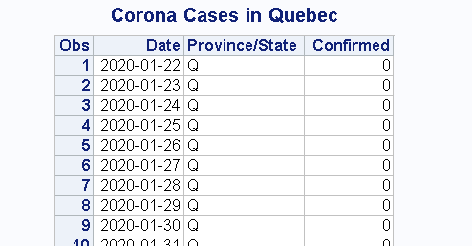
Displaying the Data
proc print data=libraryy.dataset label ; var Date 'Province/State'n Confirmed; run;
Using Proc print to display only Date provinces and Confirmed cases gives the following

Slide 12
Plotting the Data Using SGPLOT
Data libraryy.dataset; Set libraryy.dataset; Zero = 0; run; title 'Corona Cases in Quebec'; footnote j=l 'Bar Chart on Discrete Axis'; ods graphics on / /*Chart characteristics*/ width=30 in height=30 in outputfmt=gif imagemap=on imagename="MyBoxplot" border=off; proc sgplot data=libraryy.dataset; refline 1 1.5 2 / lineattrs=graphgridlines; highlow x=Date high=Confirmed low=Zero / type=bar group='Province/State'n groupdisplay=cluster lineattrs=(color=black); xaxis discreteorder=data display=(nolabel); yaxis label='Value (/ULN)' offsetmin=0;; run;

Slide 13
Explaining SGPLOT Code
Data libraryy.dataset; Set libraryy.dataset; Zero = 0; run; title 'Corona Cases in Quebec'; footnote j=l 'Bar Chart on Discrete Axis'; ods graphics on / /*Chart characteristics*/ width=30 in height=30 in outputfmt=gif imagemap=on imagename="MyBoxplot" border=off; proc sgplot data=libraryy.dataset; refline 1 1.5 2 / lineattrs=graphgridlines; highlow x=Date high=Confirmed low=Zero / type=bar group='Province/State'n groupdisplay=cluster lineattrs=(color=black); xaxis discreteorder=data display=(nolabel); yaxis label='Value (/ULN)' offsetmin=0;; run;
Add a zero value for reference
Title the dataset’s chart.
ODS Graphics for: Customizing graph Width / Height Removing border
High/Low Chart Group Display: Cluster

Slide 14
Analytics

Slide 15
To begin with, we know that the virus originated from china. So we tracked each country of our data set and observed when they each observed their first case of Corona.
/*1*/ proc sort data=probly out=sorted; where Confirmed=1; by Date; by 'Province/State'n; run; /*2*/ proc sql; create table want as select a.* from sorted a, (select 'Country/Region'n,'Province/State'n,Confirmed as _regimen from sorted group by 'Province/State'n having date=max(date)) b where a.'Province/State'n = b.'Province/State'n group by a.'Country/Region'n ,a.'Province/State'n having date=min(date) and _regimen=Confirmed; quit; /*3*/ PROC SGPLOT Data = want; scatter x = Date y = 'Country/Region'n; refline 'Country/Region'n /axis= y; refline Date /axis= x; title "First Case in various Countries"; run;
First we sort the data by date and take all the cases where there is only 1 case of corona confirmed
Using proc Sql we are using a join to eliminate the redundant case of confirmed case 1 and take only the minimum date per country and per state
Plotting a scatter plot to show the result with refline for easier reading

Slide 16
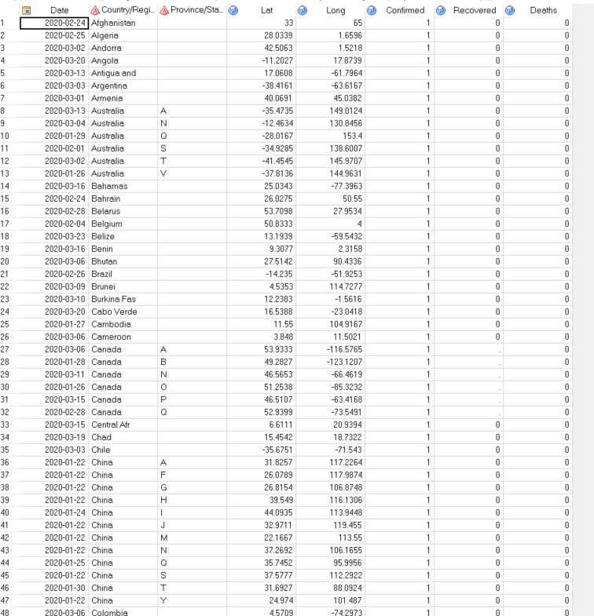
As we can observe, we get the countries and the various states in various countries

Slide 17
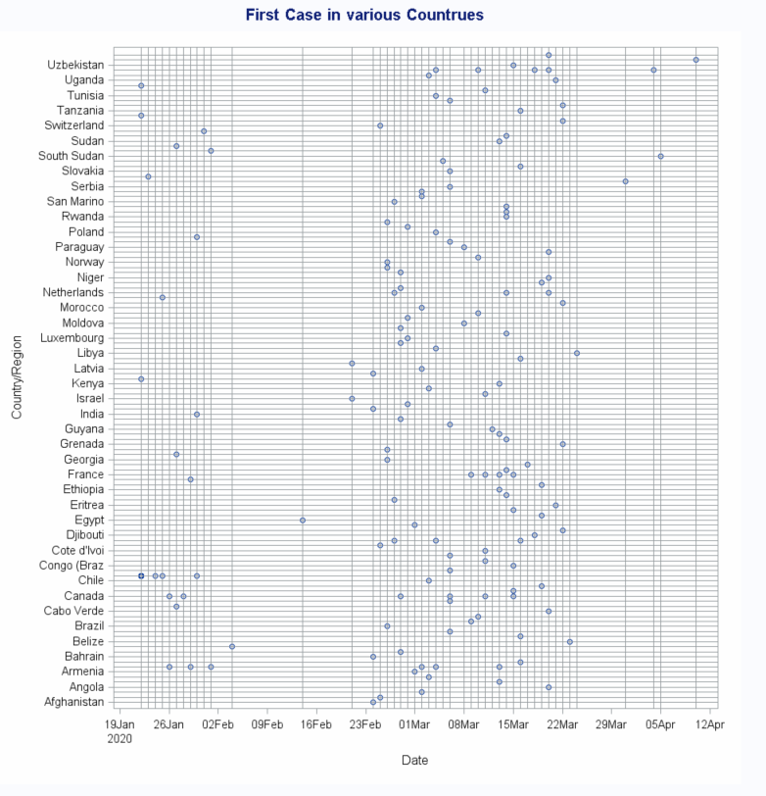
Not all countries that were described above could be shown due to lack of space
Notes:
There are some

Slide 18
/*1*/ proc sort data=probly out=sorted; where 'Country/Region'n ='Canada' and Confirmed=1; by Date; by 'Province/State'n; run; /*2*/ proc sql; create table want as select a.* from sorted a, (select 'Country/Region'n,'Province/State'n,Confirmed as _regimen from sorted group by 'Province/State'n having date=max(date)) b where a.'Province/State'n = b.'Province/State'n group by a.'Country/Region'n ,a.'Province/State'n having date=min(date) and _regimen=Confirmed; quit; /*3*/ PROC SGPLOT Data = want; scatter x = Date y = 'Province/State'n; refline 'Province/State'n /axis= y; refline Date /axis= x; /* group= 'Country/Region'n, 'Province/State'n */ /* groupdisplay=cluster lineattrs=(color=black);*/ title "First Case in Canada Provinces"; run;
If we limit the above result to focus only on the first cases in Canada
To achieve this, we simply filter the country to Canada
Stays the same
Our Scatter plot will be based on Provinces

Slide 19
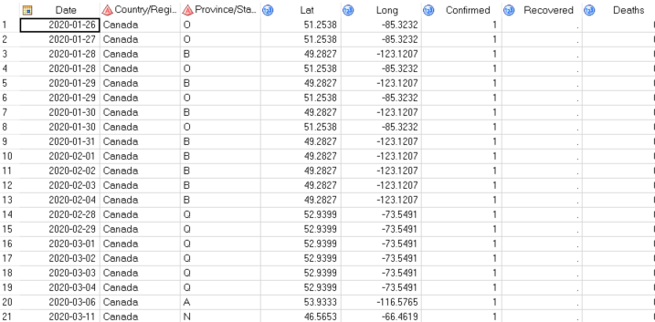
As we can observe, we get the provinces

Slide 20
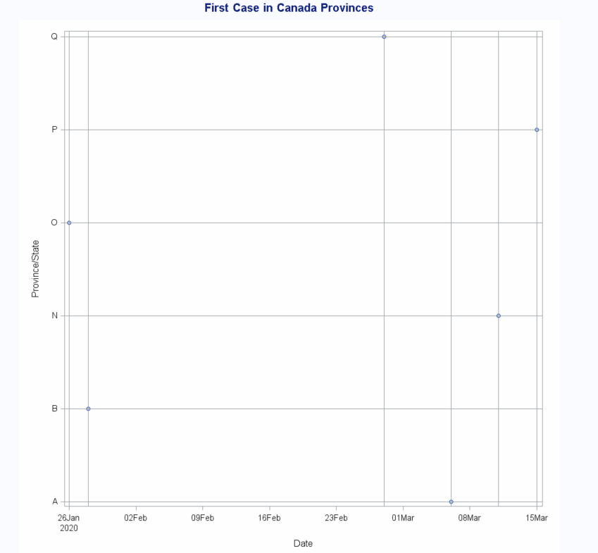
Date of First Case
in Different Canada Provinces

Slide 21
Data libraryy.dataset; Set probly (where= ( 'Country/Region'n = 'Canada' )); /*All cases in Canada confirmed cases*/ title 'Corona Cases in Canadas provinces'; footnote j=l 'Bar Chart on Discrete Axis'; ods graphics on / /*Chart characteristics*/ width=10 in height=10 in outputfmt=gif imagemap=on imagename="MyBoxplot" ; proc sgplot data=libraryy.dataset; refline 1 1.5 2 / lineattrs=graphgridlines; highlow x=Date high=Confirmed low=Zero / type=bar group='Province/State'n groupdisplay=cluster lineattrs=(color=black); xaxis discreteorder=data display=(nolabel); yaxis label='Value (/ULN)' offsetmin=0;; run;
The confirmed cases in Canada
We filter Canada as a country
Specified our graph width
plotting with a high low sgplot grouping each provinces

Slide 22
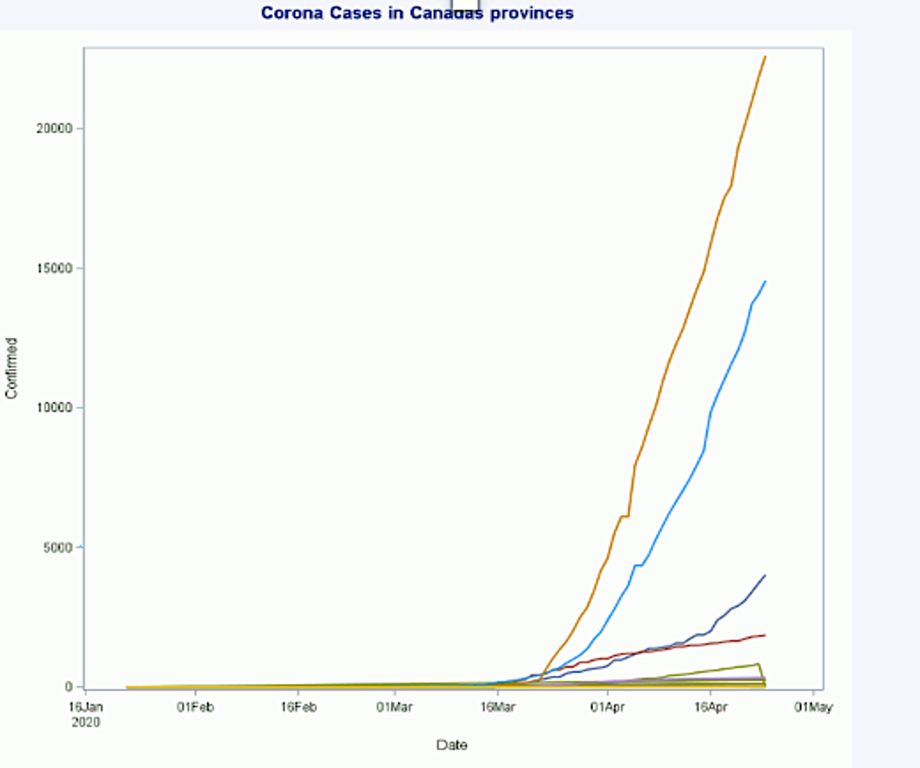

Coronavirus Cases in Canada Provinces
Quebec(Q) has the highest Number of Confirmed cases
We can observe the exponential increase in the number of cases.

Slide 23
Logarithmized confirmed number of cases
Everything stays the same as the confirmed cases in canada
We add a new column and logConfirmed
Data libraryy.dataset; Set libraryy.dataset; Zero = 0; logConfirmed = log(Confirmed); run;

Slide 24
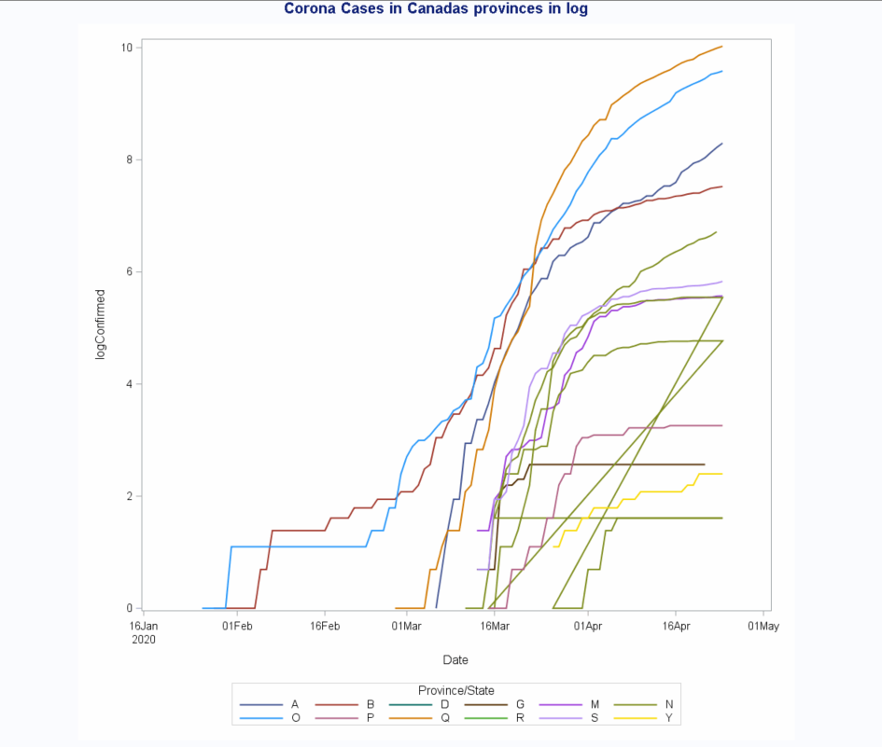

Coronavirus Cases (Log)
Creating a variable log of the deaths for the vertical scale versus the days in the horizontal scale, the slope of the curve shows the growth rate of deaths.
With this information, we can analyze which provinces are slowing down in terms of deaths.
We do this because analyzing an exponential graph to figure out when the growth slows down is tricky.

Slide 25
Data QuebecConfirmed; Set libraryy.dataset(where= ( 'Country/Region'n = 'Canada' and ('Province/State'n ='Q' ) ) ); Zero = 0; run; title 'Corona Cases in Quebec'; footnote j=l 'Bar Chart on Discrete Axis'; ods graphics on / /*Chart characteristics*/ width=30 in height=30 in outputfmt=gif imagemap=on imagename="MyBoxplot" border=off; PROC SGPLOT data=libraryy.dataset; SERIES X = Date Y = logConfirmed / LEGENDLABEL = 'Quebec' group='Province/State'n LINEATTRS = (THICKNESS = 2); XAXIS TYPE = TIME; run;
Finding the Number of Cases Solely in Quebec
Filter Canada as a country and Quebec as a province

Slide 26
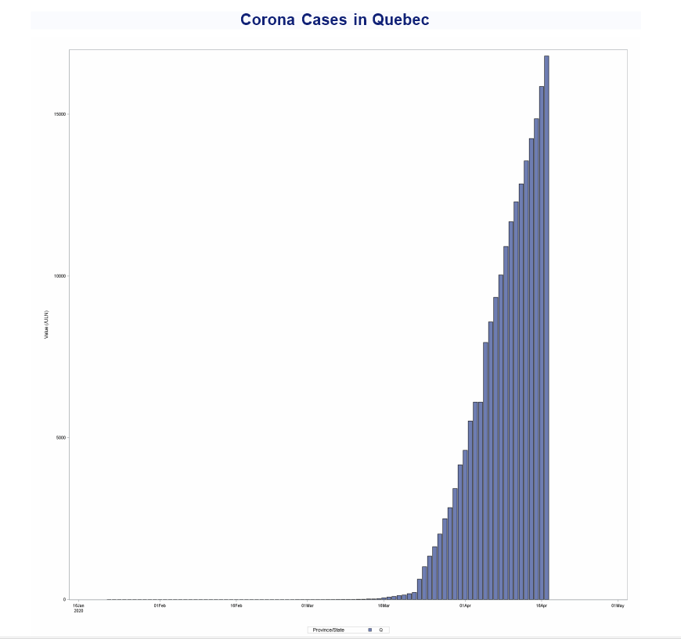
Coronavirus
Cases in QC
This number is above 20000 (22616)

Slide 27
proc sql; create table want as select a.* from sorted a, (select 'Country/Region'n,'Province/State'n,Deaths as _regimen from sorted group by 'Province/State'n having date=max(date)) b where a.'Country/Region'n = b.'Country/Region'n group by a.'Country/Region'n /*,Deaths,_regimen */ having date=max(date) and _regimen=Deaths order by _regimen desc ; quit;
Countries with the Highest Rate of Death

Slide 28
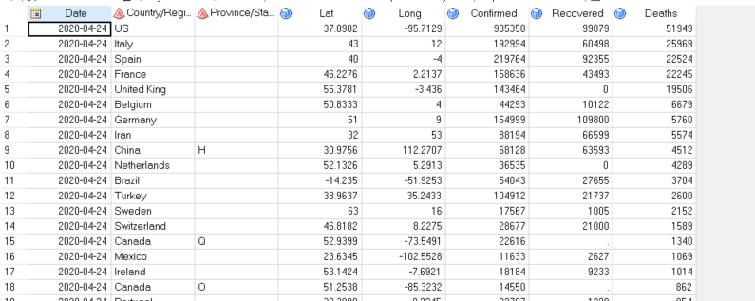
Countries with the Highest Rate of Death

Slide 29
Mortality Rate Among Top 20 Countries
Data wantDeaths10; Set want; if (Deaths > 100) then do; MortalityRate = Deaths/Confirmed*100; end; label MortalityRate = "Rate of Mortality"; /* by Deaths;*/ run; proc sort data=wantDeaths10 out=wantDeathsTop10; /*where */ by descending MortalityRate ; run; Data wantDeaths20; zero =0; Set wantDeathsTop10(obs=20); run;
We know that just the mortality rate by itself does not mean too much.
So, we took the mortality rate to get an estimate of the number of death in proportion to the number of confirmed cases
We make three dataset for easiness of reuse later. But the ultimate aim is to get the top 20 countries having the highest percentage Deaths/ConfirmedCases

Slide 30
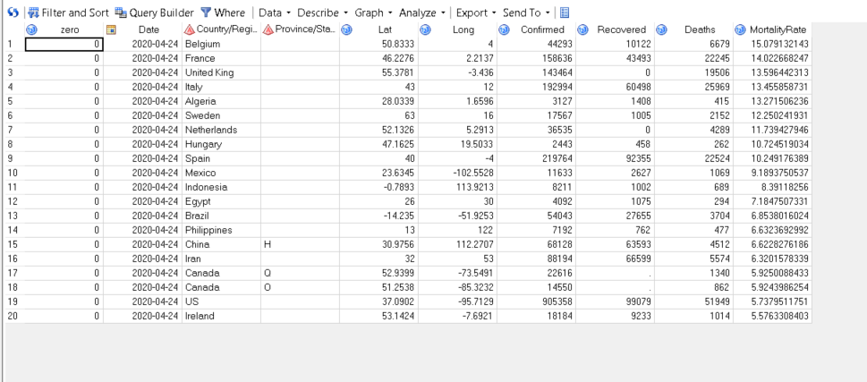

Slide 31
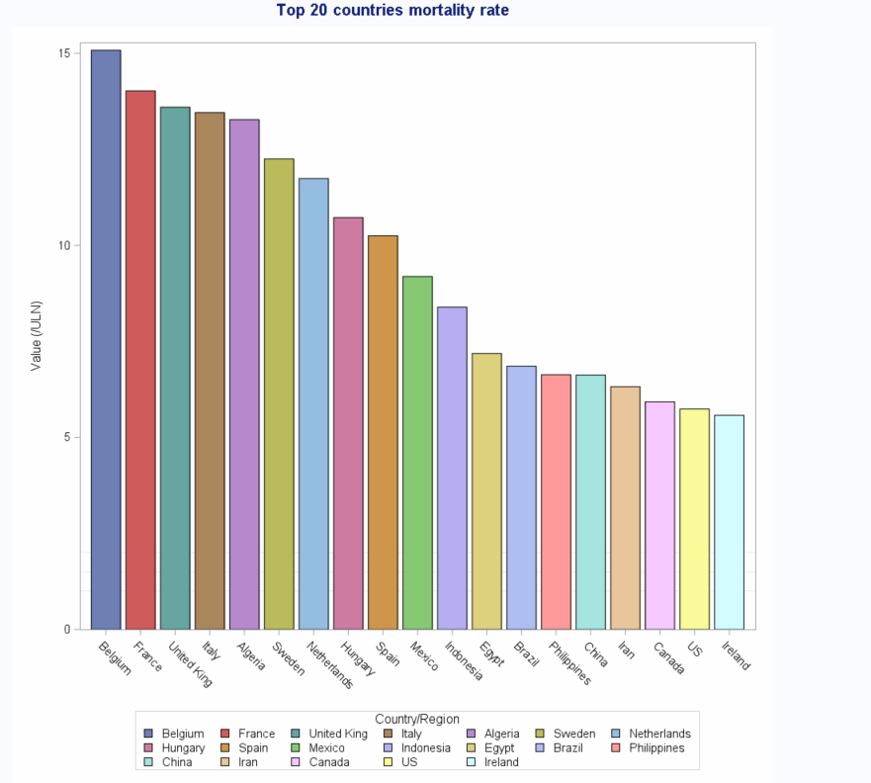
Top Countries by Mortality Rate

Slide 32
Recovery Rate Among Top 20 Countries
Data wantDeaths10; Set want; if (Recovered > 100) then do; RecoveredRate = Recovered/Confirmed*100; end; label RecoveredRate = "Rate of Recovery"; /* by Deaths;*/ run; proc sort data=wantDeaths10 out=wantDeathsTop10; /*where */ by descending RecoveredRate ; run; Data wantDeaths20; zero =0; Set wantDeathsTop10(obs=100); run; PROC SGPLOT Data = wantDeaths20; refline 1 1.5 2 / lineattrs=graphgridlines; highlow x='Country/Region'n high=RecoveredRate low=Zero / type=bar group='Country/Region'n groupdisplay=cluster lineattrs=(color=black); xaxis discreteorder=data display=(nolabel); yaxis label='Value (/ULN)' offsetmin=0;; title "Top 20 countries mortality rate"; run;
So, we took the recovered Patients/confirmed cases to find the percentage (rate) of recoveries.
We plotted the Top 10 countries with the best recovery rates.

Slide 33
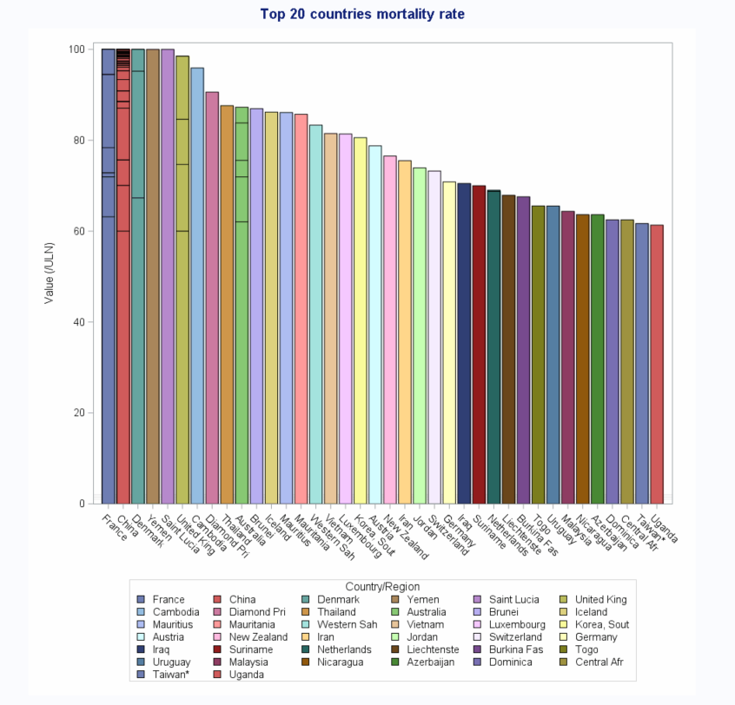
Top Countries by Recovery Rate

Slide 34
Most Confirmed COVID-19 Cases Per Capita
proc import datafile="F:\school\BSTA445\population\data\population.csv" out=mydata dbms=csv replace; run; data ret; set pop.sasSort; run; proc sort data=mydata out=sortedPop2; /* by country;*/ /* by province;*/ /* by descending date_confirmation ;*/ by 'Country Name'n; /*/*by 'Country/Region'n;*/*/; run;
A better estimate would be the number of confirmed cases per capita
totalConfirmed cases / Population Size *100
First we prepare the data for the population and sort both data in order of countries

Slide 35
PROC SQL; CREATE TABLE C AS select * FROM totalby as A left JOIN sortedPop2 as B ON A.'Country/Region'n =B.'Country Name'n where B.Year=2018 /*and */ /*B.'Country Name'n is null*/ ; QUIT; Data wantDeaths10; Set C; Zero=0; if (Value > 0) then do; MortalityRate = (TConfirmed/Value)*100; end; label MortalityRate = "Contamination percentage"; /* by Deaths;*/ run; proc sort data=wantDeaths10(DROP=Deaths Recovered Confirmed ) out=wantDeaths10sorted; by descending MortalityRate; run; data we; set wantDeaths10sorted(obs=30); run;
Most Confirmed COVID-19 Cases Per Capita
Then we do a left to keep all our data and merge it with the population csv
We take the latest dataset for population which is 2018
Then we apply our formula to get the confirmed cases per capita

Slide 36
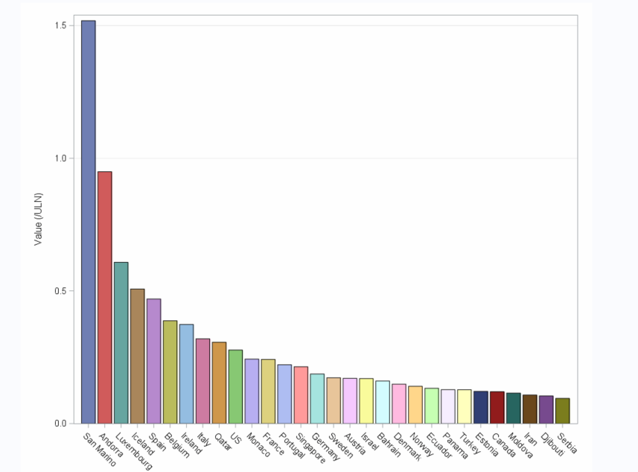

Slide 37
COVID-19 Most Deaths per Capita
proc import datafile="F:\school\BSTA445\population\data\population.csv" out=mydata dbms=csv replace; run; data ret; set pop.sasSort; run; proc sort data=mydata out=sortedPop2; /* by country;*/ /* by province;*/ /* by descending date_confirmation ;*/ by 'Country Name'n; /*/*by 'Country/Region'n;*/*/; run;
A better estimate would be the number of confirmed cases per capita
total Deathcases / Population Size *100
First we prepare the data for the population and sort both data in order of countries

Slide 38
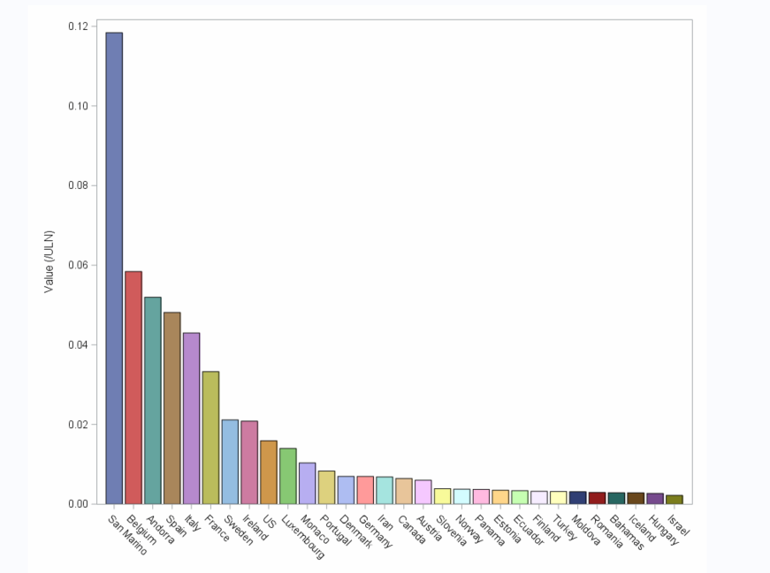

Slide 39
Least Confirmed COVID-19 Cases Per Capita
Data wantDeaths10; Set C; Zero=0; if (Value > 0) then do; TConfirmedN= (TConfirmed/Value)*100; end; label MortalityRate = "Contamination percentage"; /* by Deaths;*/ run; proc sort data=wantDeaths10(DROP=Deaths Recovered Confirmed ) out=wantDeaths10sorted; by TConfirmedN; run;
We keep the same code as in the previous example but we do not in descending order.

Slide 40
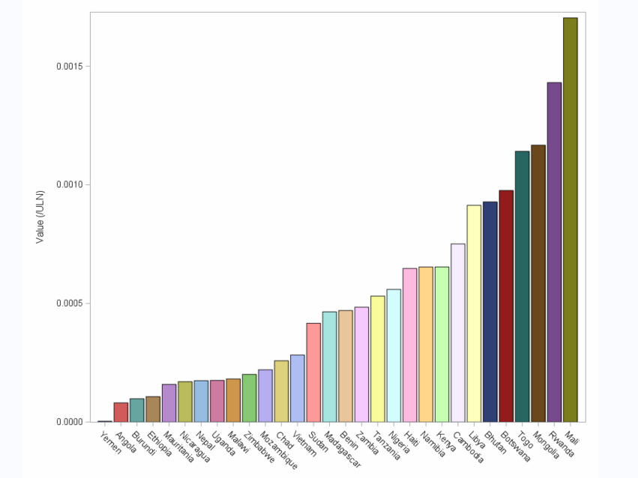

Slide 41
Least Deaths COVID-19 Cases Per Capita
Data wantDeaths10; Set C; Zero=0; if (Value > 0) then do; MortalityRate = (TDeaths/Value)*100; end; label MortalityRate = "Contamination percentage"; /* by Deaths;*/ run; proc sort data=wantDeaths10(DROP=Deaths Recovered Confirmed ) out=wantDeaths10sorted; by MortalityRate; run;
We keep the same code as in the previous example but we do not in descending order.

Slide 42
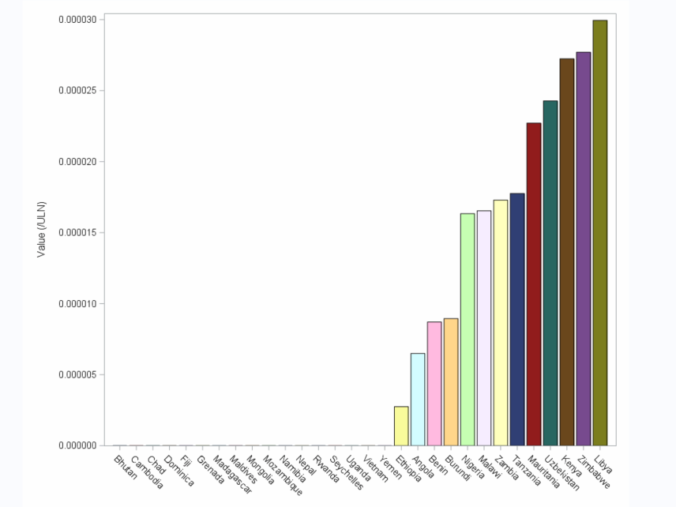

Slide 43
Conclusion
We can observe there is a link between the number of confirmed and the number of deaths with covid-19 as our most and least death per capita and confirmed cases per capita showed us. We have seen that many countries are on the right track for recovery. But drastic measures taken by countries to stay at home and take precautions while having a lockdown seems to be more effective.
Countries like Monaco, Vietnam, Madagascar, Ethopia, Nigeriam Andorra, San Marino, Mauritius, Australia, UK, Yemen, Jordan have taken the extra step to go on lockdown earlier and / or have taken drastic measures. For example Mauritius have segmentalized it’s consumer’s purchasing habits by imposing regulations that forced consumers to shop only 2 times a week . These countries’ strategy lead to the least confirming/ deaths rates while Belgium, Italy, US, France , Spain, Canada, Quebec, Israel, and others don’t seem to have implemented the best measures or have adopted them late.

Slide 44
Limitations
However, we have to be considerate, the countries with the lowest rates of deaths and confirmed cases are not targeted by massive incoming flights(Example Canada Italy) or high political barriers(Canada couldn’t close entry from us but later did) or high bureaucratic measures that has to go through many levels to be approved. Each and every country has suffered through this pandemic, and my team and i seriously hope that so each economy can get on their feet with as less damage as possible and if not much, but sufficient experience has been gathered to break through the next pandemic.
What we should take from this huge economic collapse is even the least spark detected from far in any remote country should be taken seriously and that the biggest thing to fear is not wars or anything but small microbes (as bill gates predicated in a ted talk 4 years ago).

Slide 45
Disclaimer
We guarantee in no way that the information presented above is 100% accurate since :
1)Dataset change and vary every second and we use only the source from one dataset.
2) Our population dataset dates back to 2018 and might not reflect up to date values
3) Our merging of population dataset with our corona dataset went through some data loss but it wasn’t of a huge impact and ascertained that the values were negligible
4)We thank the professor Dr. Krzysztof Dzieciolowski , the T.A Dariia Dziuba , github repositories, sas documentation and other 3rd parties for their direct and indirect help. 5)Our code is accessible from github.
We apologize beforehand for any wrongly stated fact or any missing recognition, feel free to consult/add/commit/review on the github repository

Slide 46
Bibliography
https://blogs.sas.com/content/graphicallyspeaking/2012/04/16/bar-chart-on-interval-axis/#prettyPhoto
https://github.com/datasets/covid-19
https://gist.github.com/cjdinger/2950c1a62acd7f50c33473c311b0d9fe
https://github.com/NajiElKotob/COVID-19
https://documentation.sas.com/?docsetId=grstatproc&docsetTarget=n0yadqm4wsfapgn1hzekfvu1ex0g.htm&docsetVersion=9.4&locale=en
file:///C:/Users/Joker/Downloads/Coronavirus-data-analysis-china.pdf
Yanchang Zhao yanchang@RDataMining.com http:// RDataMining.com
https://www.businessinsider.com/countries-on-lockdown-coronavirus-italy-2020-3
https://documentation.sas.com/
https://github.com/cmungun/population/blob/master/data/population.csv

Slide 47
THANK YOU
find our full code at : https://github.com/cmungun/SasProject/

